Slide 1
The University of Mississippi
NSF Major Research Instrumentation
ORSP Information Session
December 8, 2017
CME Boardroom
Notes:
Jason Hale to Start

Slide 2
Resources
The NSF MRI Home page: https://www.nsf.gov/funding/pgm_summ.jsp?pims_id=5260
The solicitation itself: https://www.nsf.gov/publications/pub_summ.jsp?WT.z_pims_id=5260&ods_key=nsf18513
FAQ: https://www.nsf.gov/publications/pub_summ.jsp?ods_key=nsf15012
Notes:
JASON HALE

Slide 3
Resources
NSF MRI Webcast
For last year’s competition
But, mostly relevant for this year’s
http://www.tvworldwide.com/events/nsf/161117/default.cfm
Notes:
JASON HALE

Slide 4
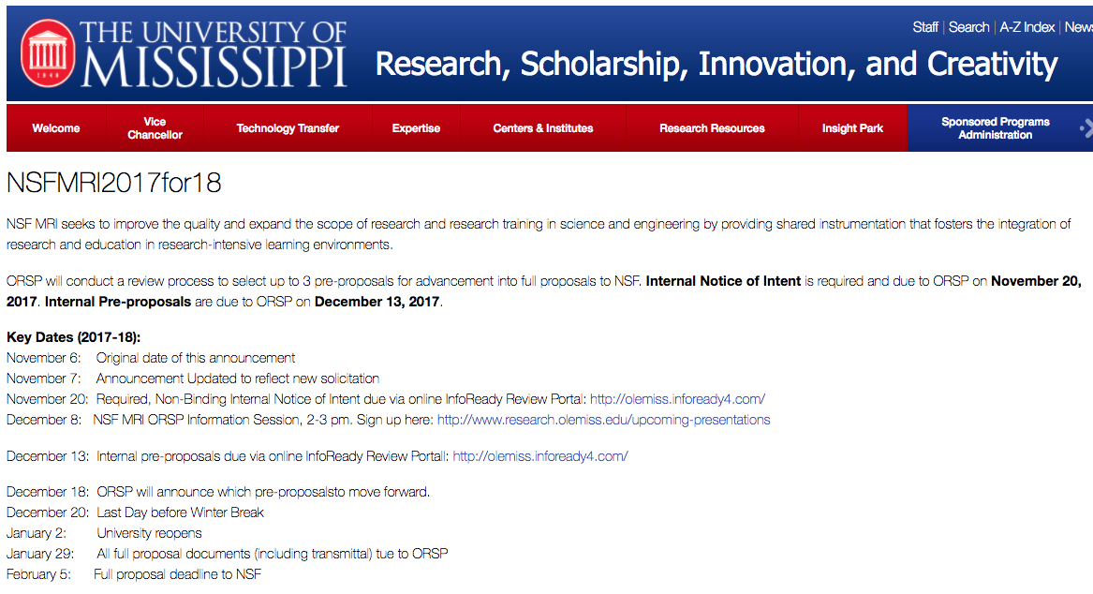
UM Process
Notes:
JASON HALE

Slide 5
UM (Oxford) Selection Process
Stage 1: Internal Notice of Intent to Apply
November 20
6 Notices received
Stage 2: Internal Application
December 13
InfoReady Review Portal
Selection: by December 18 or 19
We will let everyone know before holiday break
End of Jan: UM transmittal is due
Feb 5: Full Proposal due to NSF
Notes:
JASON HALE

Slide 6
NSF MRI Types
Acquisition
You know what you want and you can go out and buy it
Development
You know what you want and you CANNOT go out and buy it—it is not available for purchase as needed.
Notes:
JASON HALE

Slide 7
UM Internal Review Criteria
Intellectual Merit: 5 Points
Based on what is written, what is the likelihood that this instrument will advance knowledge and result in many peer reviewed research publications by many different users over the grant period and beyond.
Diversifying the STEM Workforce and Other BROADER IMPACTS: 5 Points
Based on what is written, what is the likelihood that this instrument will be used to develop a diverse STEM workforce and lead to other societal benefits?
Notes:
JASON HALE

Slide 8
UM Internal Review Criteria
Integration of Research and Training: 5 Points
Consider how well the instrument will be used not only for research but also training, and how seamlessly the two are integrated
Management Plan: 5 Points
Consider the long term plan for ensuring the instrument is maintained and operated after the grant, as well as the reasonableness of costs budgeted for calibration, operations, and maintenance.
Notes:
JASON HALE

Slide 9
UM Internal Review Criteria
Needs for Instrument at UM: 9 Points
How strong of a case did the applicant make for the need for this instrument at UM, including the projected level of use and sharing?
Notes:
JASON HALE

Slide 10
NSF Submission Limit
Two in >= $100M; < $1,000,000
One: >= $1,000,000 to $4,000,000
Refers to ask price (not total project cost)
Notes:
JASON HALE

Slide 11
Cost Share
Required, Exactly 30% of Project Cost
Or about 43% of Ask Cost
At UM this year:
All Cost Share should come from the academic units who are proposing to use the instrument
Best to line up your cost share at internal proposal time
Chairs/Deans will be asked to contribute to many proposals, but only two will be submitted, and likely a max of one will be funded
Leader of proposal should line up the cost share from the contributors
Notes:
JASON HALE

Slide 12
Review
Suggest the NSF division that funds most of the research to be conducted by the one that review it
Panel Review, Mail Review, or Combination
Funding decisions made at the Division Level
20-25% of proposals will be funded
Notes:
JASON HALE

Slide 13
Tips
Know what NSF division or director applying to supports (e.g., not medical research)
Read, mark-up, re-read, and understand the Solicitation and FAQ
E-mail you program officer to set up a phone conversation to ask questions about your proposal idea
Pay attention to the checklist in the solicitation
Notes:
JASON HALE

Slide 14
More Tips
Leverage staff with management experience in the plan to manage/operate the instrument
Data Management Plan: How data generated with instrument will be stored, shared with users and the community
Institutional Commitment:
How will the instrument be maintained and managed
Strong use, sharing, accessibility
Scope of work should match the budget
Notes:
JASON HALE

Slide 15
Integration of Research and Training
Integrate Research and Training
Not good enough to just say that you have a strong track record
Give specifics on integration
Assessment: Be sure to show how you’ll assess instrument’s success
Notes:
JASON HALE

Slide 16
Competitive Tips
Talk about the impact on the research
Talk about the impact on research training
Don’t assume users will come after you get the instrument—they need to be lined up before hand
Not enough to establish the need; more about the impact that it will have
Why us? How will it impact the institution?
If you have 20 users lined up, pick a subset to feature, and put the rest in a table
Notes:
JASON HALE

Slide 17
NSF Merit Review Criteria
Standard NSF (see page 11-12 of solicitation)
Intellectual Merit
Broader Impacts
Notes:
JASON HALE

Slide 18
FAQ: Eligible Cost Sharing
https://www.nsf.gov/publications/pub_summ.jsp?ods_key=nsf15012
Notes:
JASON HALE

Slide 19
FAQ: Auxiliary Pieces
https://www.nsf.gov/publications/pub_summ.jsp?ods_key=nsf15012
Notes:
JASON HALE

Slide 20
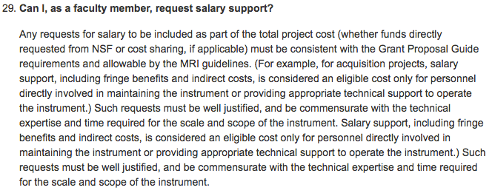
FAQ: Faculty Salary Support
https://www.nsf.gov/publications/pub_summ.jsp?ods_key=nsf15012
Notes:
JASON HALE

Slide 21
FAQ: Technician Time
https://www.nsf.gov/publications/pub_summ.jsp?ods_key=nsf15012
Notes:
JASON HALE

Slide 22
FAQ: Operations & Maintenance
https://www.nsf.gov/publications/pub_summ.jsp?ods_key=nsf15012
Notes:
JASON HALE

Slide 23
FAQ: Used Instruments
https://www.nsf.gov/publications/pub_summ.jsp?ods_key=nsf15012
Notes:
JASON HALE

Slide 24
Recent UM MRI Awards
Notes:
JASON HALE

Slide 25
Questions?
Notes:
JASON HALE

