Slide 1
ORSP Internal Grants Programs
Jason Hale
October 24, 2016
Slides Accessible at http://www.research.olemiss.edu/presentations

Slide 2
Purpose of Workshop
Increase awareness of internal grants opportunities
Increase number and competitiveness/strength of applications
UM ORSP Travel Grants Program SEC Faculty Travel Grants Program
ORSP Investment Grants Program (ORSP-IG)

Slide 3
ORSP Faculty Travel Grants Program: Purpose
http://research.olemiss.edu/resources/faculty-travel

Slide 4
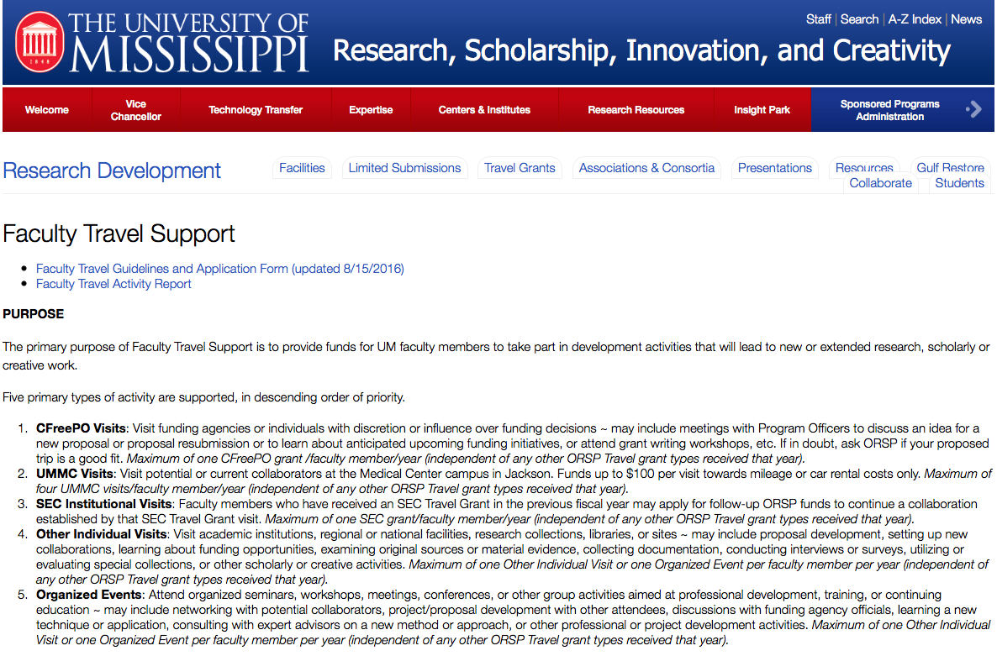
ORSP Faculty Travel Grants Program: Purpose
http://research.olemiss.edu/resources/faculty-travel

Slide 5
ORSP Faculty Travel Grants: Organized Events or Individual Visits
Give peer reviewed or invited presentations at conferences
Give creative presentations or performances
Visit academic institutions, regional or national facilities, research collections, libraries, or sites
Proposal development, setting up collaborations, learning about funding opportunities, examining original sources or material evidence, collecting documentation, conducting interviews, accessing special collections, or other scholarly or creative activities.
Maximum of one Other Individual Visit or one Organized Event per faculty member per year (independent of any other ORSP Travel grant types received that year).

Slide 6
ORSP Faculty Travel Grants: SEC Follow-On Visits
Faculty members who received an SEC Travel Grant in the previous fiscal year may apply for follow-up ORSP funds to continue a collaboration established by that SEC Travel Grant visit.
Maximum of one SEC grant/faculty member/year (independent of any other ORSP Travel grant types received that year).

Slide 7
ORSP Faculty Travel Grants: CFreePO
Conversations with Program Officers (for Free?)
Visit agencies or individuals with discretion or influence over funding decisions
Visit Program Officers to discuss an idea for a new proposal or proposal resubmission or to learn about anticipated upcoming funding initiatives
Attend grant writing workshops, etc.
LIMIT: Maximum of one CFreePO grant /faculty member/year (independent of any other ORSP Travel grant types received that year).

Slide 8
ORSP Faculty Travel Grants: UMMC Visits
Visit potential or current collaborators at the Medical Center campus in Jackson.
Up to $100 per visit towards mileage or car rental costs.
Maximum of five UMMC visits/faculty member/year (independent of any other ORSP Travel grant types received that year).
Apply once for multiple visits for the same general purpose

Slide 9
ORSP Faculty Travel Grants: Individual Visit
Visit academic institutions, regional or national facilities, research collections, libraries, or sites
Proposal development, setting up collaborations, learning about funding opportunities, examining original sources or material evidence, collecting documentation, conducting interviews, accessing special collections, or other scholarly or creative activities.
Maximum of one Other Individual Visit or one Organized Event per faculty member per year (independent of any other ORSP Travel grant types received that year).

Slide 10
ORSP Faculty Travel Grants: Limits
Only expenses related to travel and that are incurred in accordance with UM travel policies are reimbursable, up to the award amount
Funding Limits Per Award:
Maximum for domestic travel (including SEC Institutional Visits and CFreePO Visits) - $500;
Maximum for international travel - $1,000;
Maximum for UMMC Grants:
$100 per visit
$500 per grant (for up to 5 visits)

Slide 11
ORSP Faculty Travel Grants: Eligibility
Applicants must be full-time faculty members.
Applicants must be without external support related to the purpose of the travel when scheduled.
Applicants must not have yet reached the maximum number of awards allowable per fiscal year per Visit Type
Individual or Organized Event: 1 per year
CFreePO Visit: 1 per year
SEC Follow-On Visit: 1 per year
UMMC Visit: 5 per year
Applicant must not have outstanding trip reports or reimbursement vouchers from previous trips

Slide 12
ORSP Faculty Travel Grants: Priority
Priority is given to:
Junior faculty (below the rank of Associate Professor or Research Associate Professor)
Demonstrated support of Chair/Dean, such as:
Financial contributions
Letters of support (optional): should say why the Chair thinks the activity is important to the development of the faculty member
Activities that are part of a development plan, and/or where faculty will be active (not passive) participants

Slide 13
ORSP Faculty Travel Grants: Process
Complete the Faculty Travel Application Cover Page
Prepare a 1-page Summary Justification (be specific!)
Prepare itemized, estimated budget (up to 1-page), to include additional sources of funds (department, personal, etc.)
Submit all paperwork with signatures to ORSP by 5 p.m. on the 15th of each month, via Online InfoReady Review Portal: https://olemiss.infoready4.com PAPER COPIES NO LONGER ACCEPTED.
Optional letter of support from Chair may be uploaded with application, or e-mailed separately to Jason Hale (jghale@olemiss.edu).
Access forms and most up to date instructions at http://www.research.olemiss.edu/resources/faculty-travel.

Slide 14
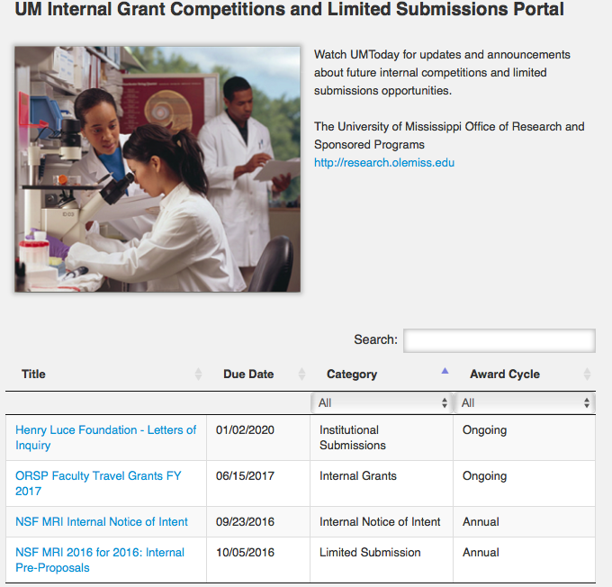
https://olemiss.infoready4.com
First time users must click Register to set up an InfoReady Review Portal account.

Slide 15
ORSP Faculty Travel Grants: Process
URB travel grants subcommittee will review/recommend
ORSP notice of any award will be communicated by 25th
Process travel authorization for ORSP approval
Travel; complete trip report (download from ORSP Web)
Submit travel reimbursement form for ORSP approval

Slide 16
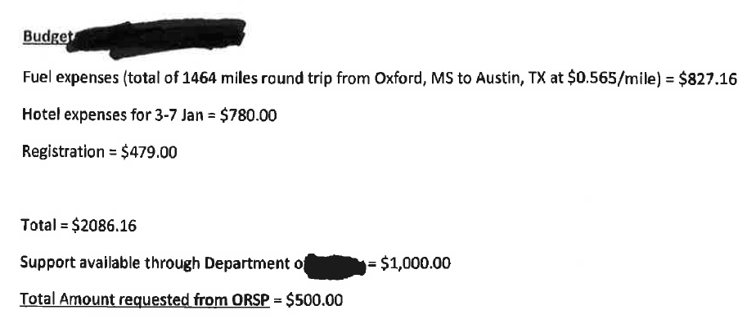
ORSP Faculty Travel Grants: Example Budget

Slide 17
ORSP Faculty Travel Grants: Statistics
FY2015
72 awards made
$45,900 given
Average: $637/award
FY2016
78 Individual & Organized Event awards made
$41,600 given
Average: $533/award
7 CFreePO awards made
$5,350 given
Average $764,award

Slide 18
ORSP Faculty Travel Grants: Frequent Gotchas
Don’t forget dean’s signature
Hard deadline of 15th of the month preceding the departure month, via InfoReady Review Portal
Hardcopy applications will not be accepted.
If you do not hear back that your grant was approved, do NOT assume that it was approved—it wasn’t, and it is possible that we never received it (sometimes they get stuck in your Dean’s office and don’t make it over here)

Slide 19
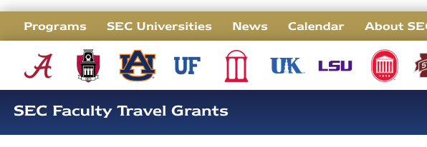
SEC Visiting Faculty Travel Grants: What They Are

Slide 20
SEC Visiting Faculty Travel Grants Program
http://research.olemiss.edu/SEC-FacultyTravel-2016
UM can access up to $10,000/year from the SECU
Funds support UM faculty members visiting other SEC universities
UM has to identify all travelers/trips before the year they travel, and request all the funds at once from the SECU
ORSP solicits applications in May for travel in planned in August – July
Pre-approved travellers obtain official invitation letters from SEC hosts
Pre-approved applications/letters are bundled into one big $10,000 request to SECU, submitted by ORSP on behalf of Provost
SECU issues $10K award to UM; ORSP manages award for the Provost
ORSP approves travel authorizations and signs reimbursement vouchers
Faculty submit trip reports to ORSP; Provost sends final report to SECU.

Slide 21
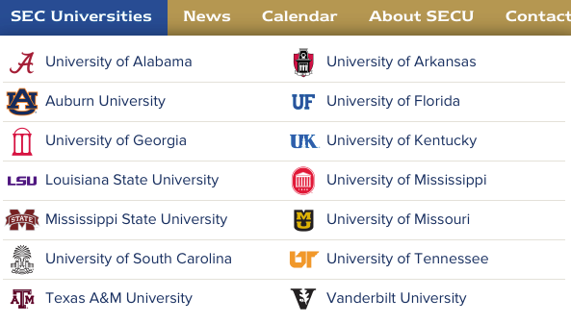
SEC Visiting Faculty: What are the SEC Schools?

Slide 22
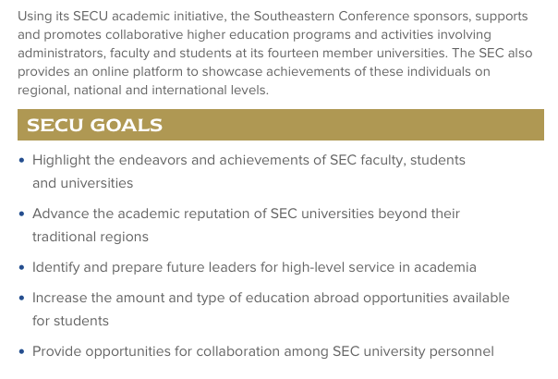
SECU: The Southeastern Conference’s Academic Initiative

Slide 23
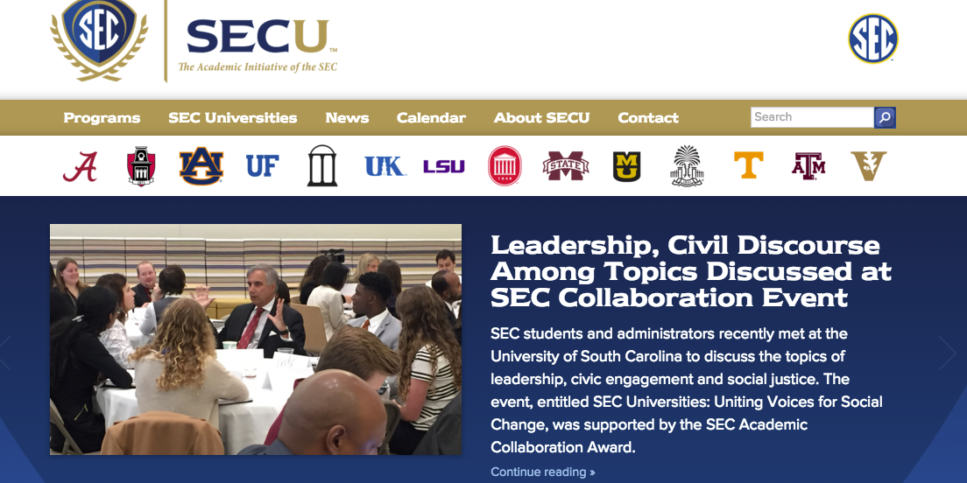
The SECU
www.thesecu.com

Slide 24
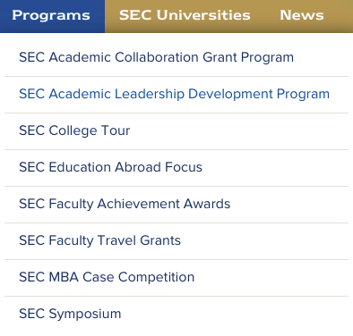
SECU Programs

Slide 25
SEC Visiting Faculty Travel Grants: 2014-15 UM Statistics
9 applications received
9 awards made
12 UM faculty travelers
2 UM colleges/schools
6 academic departments
59 travel days
6 host SEC institutions
$10,000 given by SECU (this number is fixed yearly)

Slide 26
SEC Visiting Faculty Travel: Activity Types
Eligible Activities:
Consulting with faculty or students at host site
Offering lectures or symposia
Presenting a recital
Engaging in other scholarly activities agreeable to the host unit (if in doubt, e-mail Jason Hale at jghale@olemiss.edu)

Slide 27
SEC Visiting Faculty Travel: Limitations
Grant amounts: $500 to $1,500
Travel between 8/1/2017 and 7/31/2018
Only expenses related to travel of the faculty member, and that are incurred in accordance with UM travel policies are reimbursable, up to the award amount
Must be able to produce a formal letter of invitation from the host unit within 10 days of notice of award
Only travel to SEC campuses or SEC affiliated locations

Slide 28
SEC Visiting Faculty Travel: Strong Applications
Priority is given to:
Junior faculty (below the rank of Associate Professor or Research Associate Professor)
Demonstrated support of Chair/Dean, such as:
Financial contributions; Letters of support
Activities that are part of a development plan, and/or where faculty will be active (not passive) participants
Applications with Letters of Invitation from Host Already In-Hand

Slide 29
SEC Visiting Faculty Travel Grants: Process
Prepare a 1-2 page proposal, consisting of:
Description of proposed activities
The host unit and school
Expected scholarly benefits
A detailed budget and justification (including any funds being contributed by Chair, Dean, or other source)
Include a letter of support from Chair and/or Dean, including any specific or general offer of financial support
Submit all to UM ORSP by 5/02/2017 via Ole Miss InfoReady portal at https://olemiss.infoready4.com/

Slide 30
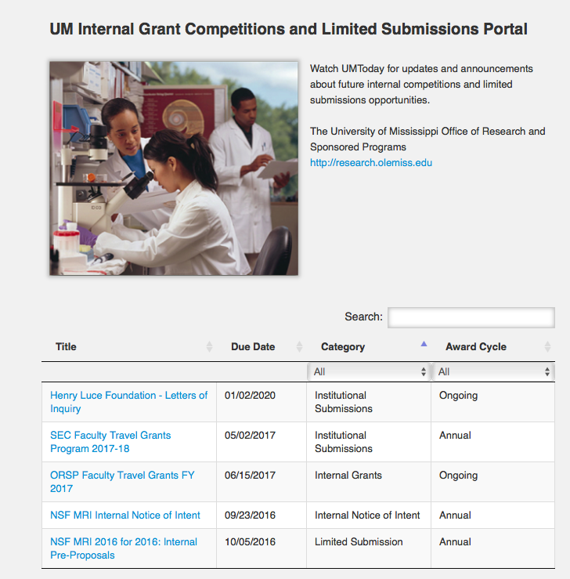
https://olemiss.infoready4.com
First time users must click Register to set up an InfoReady Review Portal account.

Slide 31
SEC Visiting Faculty Travel Grants: Process (cont.)
URB travel grants subcommittee will review/recommend
Tentative notice of awards will be communicated by 5/22/17
Obtain official invitation letter from host by 6/11/2017
ORSP will submit combined application for all travelers to SECU by 7/31/2017
Process travel authorization for ORSP approval
Travel; submit 1-page trip report to ORSP within 30 days
To host another SEC faculty member at UM, that faculty member should apply through their own university.

Slide 32
UM SEC Faculty Travel Grant Awardees, 2013-14
Amanda Johnston, Assistant Professor of Music. $560 for travel to Vanderbilt University and LSU. Presented guest artist recitals
Adam Estes, Assistant Professor of Music. $560 for travel to Vanderbilt University and LSU. Performed guest artist recitals
Barbara Combs, Assistant Professor of Sociology & Southern Studies. $963 for travel to the University of South Carolina. Worked with collaborators on current and future projects, lead class meeting, and reviewed preliminary data from pilot project.
Brian Platt, Assistant Professor of Geological Engineering. $1,058 for travel to the University of Arkansas. Lectured on his collaborative research project, learned software, collected data and discussed future direction of collaborative work.
Carolyn Freiwald, Assistant Professor of Archeology. $1,033 for travel to the University of Florida. Accessed skeletal collections at the FL Museum of Natural History, discussed collaborative efforts, gave seminar.
Carrie Smith, Instructional Assistant Professor of Psychology. $666 for travel to the University of Florida. Worked on joint manuscript, discussed comments on a separate publication and lectured.
Greg Love, Assistant Professor of Political Science. $880 for travel to Vanderbilt University. Worked on NSF grant proposal; met with director of Latin American Public Opinion Project to discuss changes for a proposed publication.
Joel Amidon, Assistant Professor of Teacher Education. $868 for travel to the University of Georgia. Gave a seminar.
John Green, Associate Professor of Sociology. $608 for travel to the University of Missouri-Columbia. Discussed creating multi-state Delta region population research mini-conference, lectured, met collaborators.
Lindy Brady, Assistant Professor of English. $908 for travel to the University of Arkansas. Lectured; began planning a new southern Celtic Studies consortium.
Micah Milinovich, Assistant Professor of Mathematics. $833 for travel to the University of Georgia. Lectured and collaborated with a colleague on a research project.
Chris Newman, Assistant Professor of Marketing. $652 for travel to the University of Arkansas. Collected data in a retail laboratory with collaborators.

Slide 33
UM SEC Faculty Travel Grant Awardees, 2014-15
Brad Campbell, Instructor and Oxford Campus Writing Center Director: Writing and Rhetoric. $1229 for travel to Texas A&M. Collaborated on ways to improve competencies in communication.
Jody Holland, Assistant Professor of Public Policy Leadership. $1225 for travel to University of Georgia. Examined Center of Agribusiness and Economic Development.
Eric Weber, Associate Professor of Public Policy Leadership. $497 for travel to Texas A&M. Presented book to faculty and students.
Michael Rowlett and Adam Estes, Associate Professor and Assistant Professor of Music. $1409 for travel to University of Missouri and University of Arkansas. Presented Chamber music concerts and interacted with Masters classes.
Maureen Meyers, Assistant Professor of Sociology and Anthropology. $830 for travel to University of Georgia. Worked with collaborators in archaeology and curating; lectured and held research meetings with students.
.
Amanda Johnston and Nancy Maria Balach, Associate Professors of Music. $955 for travel to University of Arkansas. Gave music performances and conducted master classes.
Haidong Wu, Professor of Mathematics. $1310 for travel to Louisiana State University. Collaborated on research in combinatorics leading to publications.
Eric Lambert and Linda Keena, Chair/Professor and Associate Professor of Legal Studies. $576 for travel to Mississippi State University. Developing a survey instrument for Mississippi Corrections Department staff.
Yang-Chieh Fu, Assistant Professor of Health, Exercise Science, and Recreation Management. $1969 for travel to University of Georgia. Building connections and collaborations to lead to external grant proposals.

Slide 34
UM SEC Faculty Travel Grant Awardees, 2015-16
Jamie Cantrell, Visiting Assistant Prof of English. $2,213 for travel to TAMU LGBT Archive.
James Cizdziel, Assoc. Prof. of Chemistry & Biochem. $1,256 for travel to Univ. of S. Carolina. Forensic chemistry research collab. & instrument access.
Jandel Crutchfield, Assistant Professor of Social Work. $394 for travel LSU. Research collaboration planning, including charter school heterogeneity.
Matthew DiGiuseppe, Assistant Professor of International Relations. $713 for travel to UGA. Collaborated on research paper on Labor Rights & Economic Competition.
Conor Dowling, Assistant Professor of Political Science. $1,282 for travel to LSU collaborate on research related to American Voter Knowledge, Perception, & Misperception.
.
April Holm, Assistant Professor of History. $1223 for travel to the University of Missouri. Conducted research on provost marshals in the American Civil War.
Jos Milton, Amanda Johnston, Music. $1048 for travel to the University of Georgia. Performed multi-media song presentation of Franz Schubert’s Winterreise.
Elizabeth Payne, Professor of History. $1246 for travel to the University of Arkansas. Collaborated and gave presentation on Depression-Era Arkansas Documentary Photography.

Slide 35
UM SEC Faculty Travel Grant Awardees, 2016-17
Jeffrey Watt, Cook Chair and Professor of History. $500 for travel to the University of Alabama to present a paper on Calvinist Geneva.
Robert Barnard, Associate Professor of Philosophy. $750 for travel to University of Alabama to explore forming regional working group on truth & related philosophical issues.
Susan Loveall-Hague, Assist. Prof. of Communications Sciences & Disorders. $1,900 for travel to Univ. of Alabama to collaborate on examining strengths and weaknesses of reading skills in individuals w/ Down Syndrome.
Katherine Dooley, Assistant Prof. of Physics & Astronomy. $1700 for travel to LSU to collaborate on gravitational wave detection projects.
Micah Milinovich, Associate Professor of Mathematics. $1,400 for travel to University of Missouri to continue collaborative research concerning the distribution of the zeros of the Riemann zeta function.
Adam Estes, Assistant Professor of Music. $800 for travel to University of Georgia to participate in an SEC Saxophone Summit, teach a master class, and give a collaborative musical performance with UGA students.
Samuel Lisi, Assistant Professor of Mathematics. $1750 for travel to the Univ. of Arkansas to collaborate with co-author on a book project, speak at dept. seminar, and meet w/ graduate students.
Eric Lambert, Chair/Professor and Associate Professor, of Legal Studies, with Linda Keena, Associate Professor of Criminal Justice. $600 for travel to Mississippi State University to collaborate on scholarly publications and grant proposals aimed at enhancing MS prisoner rehabilitation and reintegration programs.

Slide 36
ORSP-IG: Investment Grants
Pilot program stimulate sustainable, competitive research and scholarship by:
facilitating preliminary data collection for funding applications
improving grantsmanship/increasing competitiveness for grants
facilitating collaborations among diverse scholar/researchers
providing opportunities to mentor/supervise students in research—especially undergraduates and all students from underrepresented groups
promoting scholarly activities aligning with UM strategic goals and initiatives
supporting activities that lead to the advancement of UM faculty/researchers

Slide 37
ORSP-IG: Inspired by UM2020 Strategic Plan
In UM2020 Strategic Plan, UM committed to:
“stimulate interdisciplinary study and research”
“increase support for graduate students in a variety of ways”
“increase individual and collaborative research, scholarship, and innovation”
“devise strategies to increase success in garnering competitive grants”
“engage in a disciplined investment strategy supporting research/scholarship”
“strengthen the rigor and impact of … internal grants aimed at increasing individual productivity and programmatic growth”
http://um2020.olemiss.edu/

Slide 38
ORSP-IG: Review Criteria (previous rounds)
Intellectual Merit (20%): The proposal appears to demonstrate potential to build upon and advance established knowledge—expressed in a way that educated lay readers can understand the project at a high level.
Soundness of Plan and Reasonableness of Request (20%): Does the project seem doable with available resources (personnel, time, equipment, money)? Is there a realistic timeline? Is the budget sufficient but not excessive to achieve the stated objectives? Is it clear what the funds are being spent for and why? Will funds enable activities not possible without this grant? Is the request reasonable given other resources that should reasonably be expected to be available to the proposer/team?

Slide 39
ORSP-IG: Review Criteria (previous rounds)
Grantsmanship (10%): The clarity of the proposal in conveying the goals, objectives, activities, and outcomes. Is the proposal easy to read by educated lay readers? Is it professionally written? Well organized?
State or National Impacts (10%): Do proposed activities align with and advance high priorities of U.S. national interest and documented goals and initiatives of the State of Mississippi, including the MS Science and Technology Plan, Blueprint Mississippi, the MS Development Authority, the MS Energy Institute, and/or MDA target industries?
The Mississippi Science & Technology Plan: http://research.olemiss.edu/MissScienceAndTechPlan
Blueprint Mississippi: http://www.msmec.com/blueprint-mississippi
The Mississippi Energy Institute: http://www.mei.ms
Mississippi Development Authority Targets: http://www.mississippi.org/locate-here/target-industries/

Slide 40
ORSP-IG: Review Criteria (previous rounds)
Institutional Impacts (20%): Will proposed activities demonstrably advance institutional goals, including those in the UM2020 Strategic Plan or the Extended Sensitivity and Respect Committee recommendations? (e.g., create a culture of research excellence related to race; increase the role of graduate students in research and innovation; increase collaborative research, scholarship, & innovation; increase success in garnering competitive grants; stimulate undergraduate research)
Development Impacts (10%): The likelihood that this project will lead to a research program that will be self-sustaining (e.g., competitive for external grants and contracts) and/or that it will help the applicant achieve promotion.
Measurable Objectives (10%): The proposal establishes objectives and is likely to achieve outcomes that can be independently measured one year out and three years out. (e.g., submit a proposal to sponsor that is recommended for funding, etc.)

Slide 41
ORSP-IG: Review Process
ORSP seeks volunteers from the UM research community and beyond to read, score, and provide feedback on proposals according to established review criteria and using a corresponding rubric provided by ORSP.
Depending on the # of volunteers, each proposal will be independently reviewed and scored by 3 to 5 individuals, most or all of whom will not be experts in the discipline(s) of the proposing individual/team, but many of whom will be experienced in writing competitive proposals.
ORSP will review/compile the scores/feedback, select the awardees from among the highest scoring proposals, and return the reviewers’ scores and feedback to all proposers

Slide 42
ORSP-IG: Awards and Requirements
Awardees are required to sign an award agreement with ORSP
Funds are transferred to a new research account under the control of the PI
Awardees are asked to submit an abstract for a poster or 3 minute lecture at the annual UM/UMMC Research Day
Awardees must submit mid-term and final reports to ORSP

Slide 43
ORSP-IG: Round 1 Awards
“Identifying Neural Correlates of Increased Fluency Due to Multi-Modal Speech Feedback in a Stuttering Population”
Dwight Waddell, associate professor of electrical engineering
“Characterizing Gunshot Residue from a Firearm Containing 3D Printed Components: Feasibility of Collecting and Fingerprinting Polymer Residue using Thermal Analysis and Mass Spectrometry”
James Cizdziel, associate professor of chemistry and biochemistry
“Mapping Language and Culture”
Allison Burkette, associate professor of modern languages
“Archeology Chemistry: Identifying Migration and Trade in Mesoamerica”
Carolyn Freiwald, assistant professor of sociology and anthropology
“An International Graduate Program in Gravitational Physics”
Emanuele Berti, associate professor of physics and astronomy
“Collaborative Political Science Survey Research”
Conor Dowling, assistant professor of political science
“Toward a better understanding of groundwater recharge in the Mississippi Delta in support of sustainable aquifer management”
Andrew M. O’Reilly, assistant professor of geology and geological engineering
“The Effects of Authoritarian Iconography: An Experimental Test”
Yael Zeira, Croft assistant professor, political science and international studies
“Documenting Mississippi Stories”
Ted Ownby, professor of history, director of the Center for the Study of Southern Culture
Visualization and Development for the SHE™ Application”
Phillip Rhodes, associate professor of computer and information science
“Recovering the Lost Library of Chartres: Pioneering the Digital Future of the Past at the University of Mississippi”
Gregory Heyworth, associate professor of English

Slide 44
ORSP-IG: Round 2 Awards
Applicant | Primary Appointment Title | Dept | Request | Total Award | ORSP Contribution | Dean Contribution | Provost Contribution | Chair Contribution
Platt, Brian | Assistant Professor | Geology & Geol. Engr. | $7,171 | $7,171 | $7,171
Brooks, Tracy | Assistant Professor | BioMolecular Sciences | $8,156 | $8,156 | $8,156
Thomas, James | Assistant Professor of Sociology | Sociology & Anthropology | $5,045 | $5,045 | $5,045
Gochfeld, Deborah | Principal Scientist | NCNPR | $5,990 | $5,990 | $2,995 | $2,995
Boudreaux, Edmond | Director, Center for Archaeological Research | Sociology & Anthropology | $9,943 | $9,943 | $2,485.75 | $3,971.50 | $2,486 | $1,000.00
Buchholz, Richard | Associate Professor | Biology | $8,367 | $8,367 | $2,367.00 | $0.00 |  | $6,000.00
Pedigo, Susan | Professor, Department of Chemistry and Biochemistry | Chemistry | $5,200 | $5,200 | $1,733.33 | $966.67 |  | $2,500.00
Otts, Stephanie | Sr. Research Counsel, Dir. Sea Grant Programs | MLRI | $7,000 | $7,000 | $7,000 | $0
Boudreaux, Edmond | Director, Center for Archaeological Research | Sociology & Anthropology | $9,942 | $3,300 | $1,150 | $1,150 |  | $1,000
Symula, Rebecca | Instructor of Biology | Biology | $4,542 | $4,542 | $1,500 |  |  | $3,042
Ozeren, Yavuz | Research Scientist | NCCHE | $4,888 | $4,888 | $1,222 | $3,666
Nouranian, Sasan | Assistant Professor | Chemical Engineering | $6,000 | $6,000 | $1,500 | $4,500
Fennelly, Beth Ann | Prof. of English and Director of MFA Program | English | $2,273 | $2,273 | $1,136.50 | $0.00 |  | $1,136.50
Johnson, Willa | Associate Professor | Sociology & Anthropology | $6,163 | $6,100 | $2,100 | $3,000 |  | $1,000
DiGiuseppe, Matthew | Assistant Professor of International Relations | Political Science | $2,880 | $2,888 | $1,444 |  |  | $1,444
Johnson, Kirk | Associate professor of Sociology and African American Studies | Sociology & Anthropology | $4,537 | $2,847 | $1,000 | $1,847 |  | $0
Crutchfield, Jandel | Assistant Professor | Social Work | $1,660 | $1,660 | $830 |  |  | $830
Amidon, Joel | Assistant Professor | Teacher Education | $4,900 | $4,900 | $2,450.00 |  |  | $2,450.00
TOTAL |  |  |  | $96,270 | $51,286 | $22,096 | $2,486 | $20,403

Slide 45
ORSP-IG: Round 3 Request for Proposals
Plans are still being made for a possible Round 3 in 2016-17
Watch UMToday for announcements (at least once a month)

Slide 46
End of Workshop
Questions?

